Slide 1

About the Instructor

Slide 2


About the Instructor
First name: Jack Last name: Hong Nationality: Singaporean
Domain and technical expertise: Empirical Finance, Statistics, Machine and Deep Learning modeling, Full Stack coding
Research areas: Empirical Corporate Finance, Network centrality, Natural Language
Current Appointments
Director and Chief Executive Officer JCube Capital Partners
AI-driven portfolio selection
Co-founder Research Room
management consulting, data analytics, and AI modeling
Adjunct Faculty Singapore Management University
Undergraduate, MBA, Doctoral Studies
Director and Board Member Urband International
Global eyewear design and distribution
Chief Scientist Asia Finance
Personal Finance
My favourite ramen ~
六厘舎 rokurinsha

Slide 3

About the Instructor
Dr. Jack Hong
Email: jackhong@smu.edu.sg | jack@researchroom.sg | jack@jcubefund.com
In a past life…
Ph.D. Candidate and Researcher SMU
Asset pricing; Information credibility; Market anomalies
Natural language programming; Social network centrality
Corporate Planner CapitaLand China & Ascott North Asia
Private Equity; Corporate Planning; Strategy and Research
Staff Officer Ministry of Defence
International Relations (Bilateral)
Organizing Secretariat Monetary Authority of Singapore
IMF-World Bank Annual Meetings; Singapore 2006

Slide 4
This course has wide applications outside of academia research: building blocks of Artificial Intelligence applications
Domain Expertise
Data
Algorithms
What is Artificial intelligence?
a set of research designs and computational techniques used to train a machine
based on known/observed data
to predict outcomes with the accuracy exceeding that of a bunch of domain experts
Models
Rules
AI
BI
AI: Artificial Intelligence
BI: Business Intelligence

Slide 5

The Rise of Artificial Intelligence
Critical TECHNOLOGY elements supporting the rise of AI
Next-gen computing architecture (Hi performance computing)
Advances in algorithms
Data, data, and more data
Critical USE-CASE elements supporting the rise of AI
Rules-based or Autonomous
In the past, a rules-based approach to real life problems was preferred
However, the complex problems we see today cannot be effectively solved by using deterministic rule-based systems
We don’t know what we do not know!

Slide 6



That is what AI is for
Definition of AI by Gartner
Able to adapt its behavior based on experience
Totally independent on instructions from people
Able to come up with unanticipated results

Slide 7
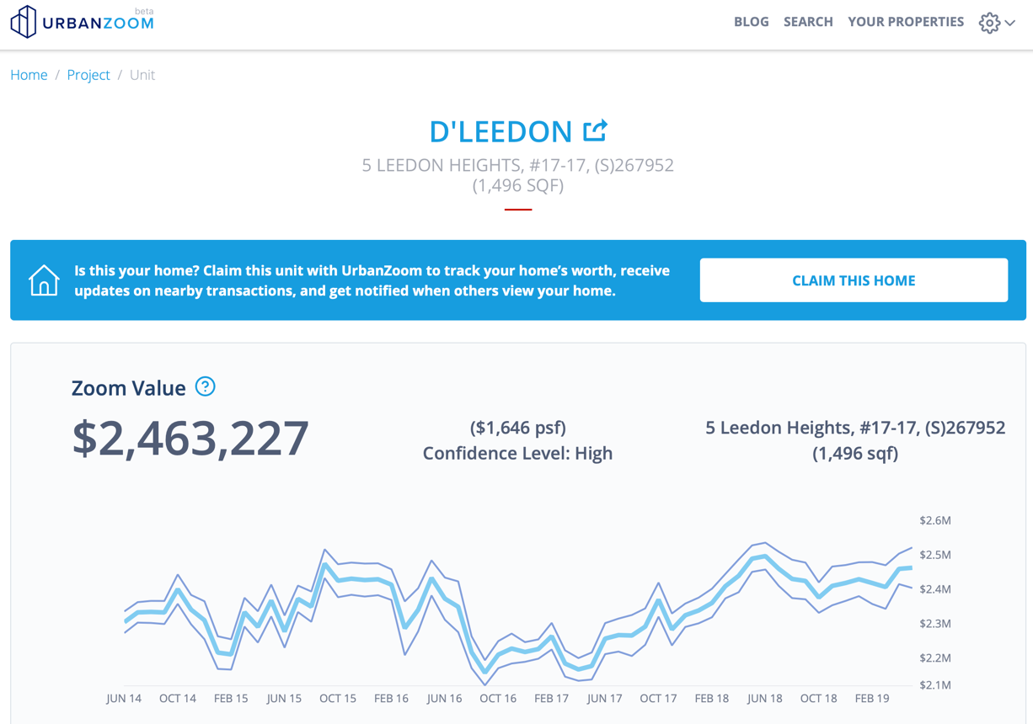
Example of AI + domain expertise application: Home Autovaluation

Slide 8
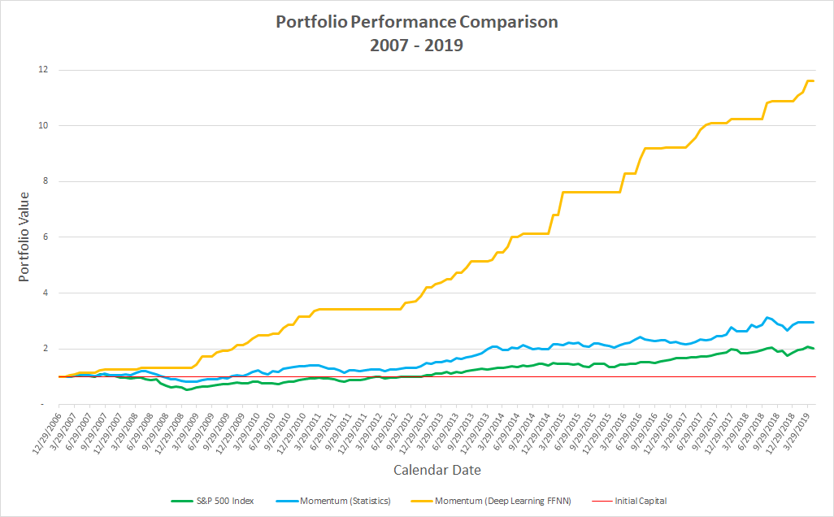
Another example of AI + domain expertise application: Portfolio Construction

Slide 9
Admin

Slide 10
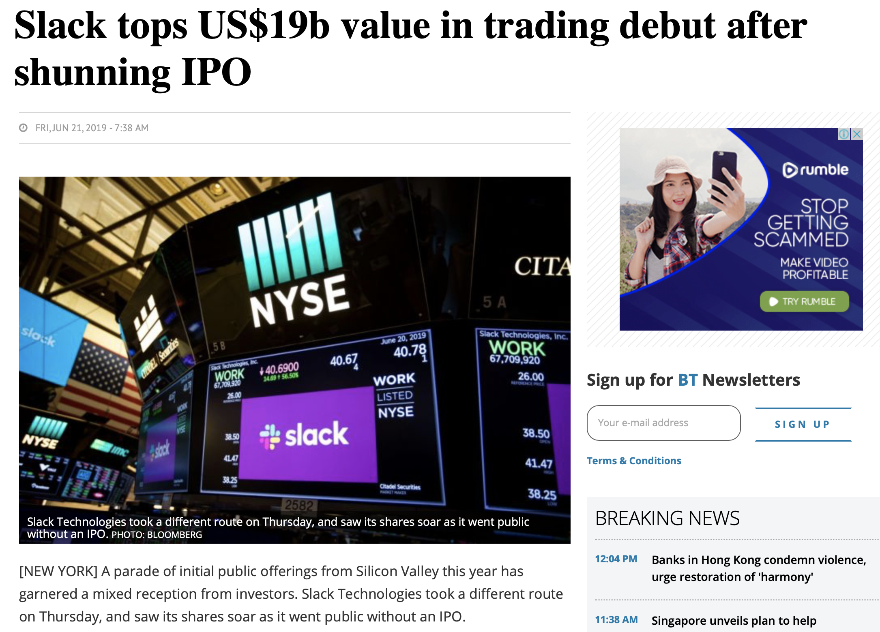
Team Communications
Content and data are posted on Slack
Invitation link to Slack > https://tinyurl.com/yxltj9e9
Is Slack sustainable?

Slide 11
Coding Platform
Coding can be done on either my JupyterHub server or Google Colab (colab.research.google.com)
You will need to register a github account to access my server (www.github.com)
JupyterHub has established itself as the common coding interface for data science environments, including commercial platforms:
Google Colab
AWS Sagemaker
We will use Google Colab most of the time
The data for this workshop is shared on Google Drive > https://tinyurl.com/yybaonr5
In the final lesson, we may go through the following installations on your computer:
Python 3 and essential libraries
R, R Studio and essential libraries
Jupyter notebook
(Optional) Pycharm for aspiring Python developers

